Slide 1
Extra Credit:
Binary File Operations

Slide 2
fstream Object
fstream object can be used for either input or output
Must specify mode on the open statement
Sample modes:
  ios::in – input
  ios::out – output
Can be combined on open call:
  dFile.open("class.txt", ios::in | ios::out);

Slide 3
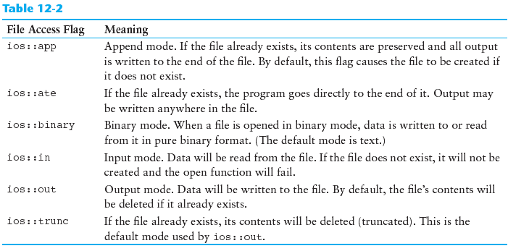
File Access Flags

Slide 4
Passing File Stream Objects to Functions

Slide 5
Passing File Stream Objects to Functions
It is very useful to pass file stream objects to functions
Be sure to always pass file stream objects by reference

Slide 6
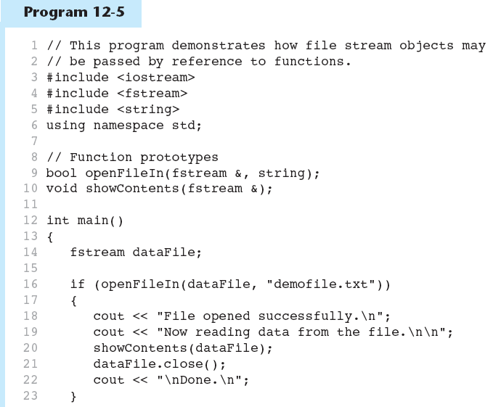

Slide 7
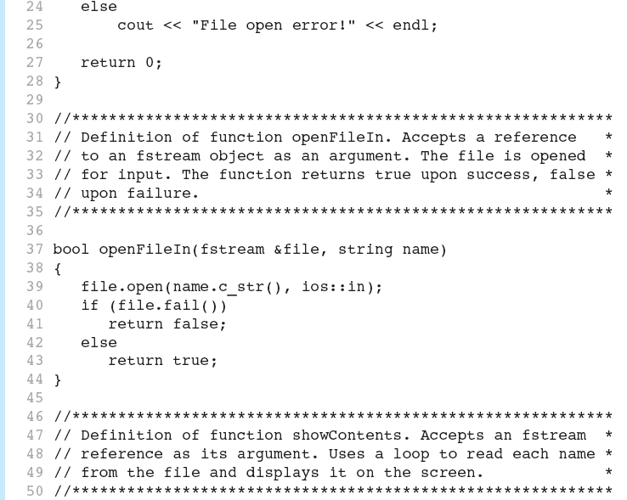

Slide 8
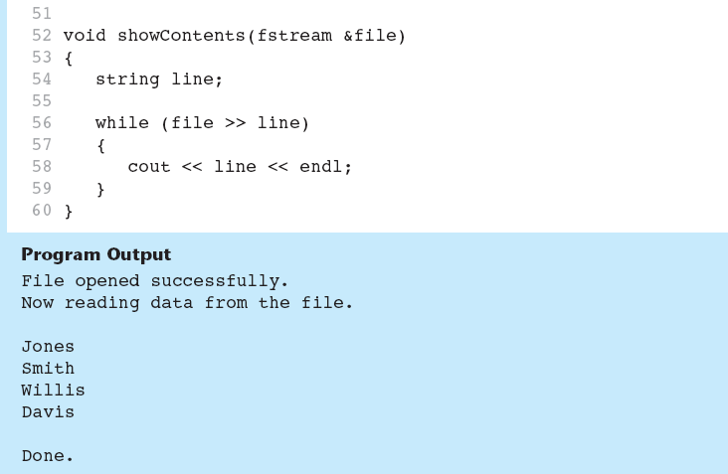

Slide 9
More Detailed Error Testing

Slide 10
More Detailed Error Testing
Can examine error state bits to determine stream status
Bits tested/cleared by stream member functions
ios::eofbit | set when end of file detected
ios::failbit | set when operation failed
ios::hardfail | set when error occurred and no recovery
ios::badbit | set when invalid operation attempted
ios::goodbit | set when no other bits are set

Slide 11
Member Functions / Flags
eof() | true if eofbit set, false otherwise
fail() | true if failbit or hardfail set, false otherwise
bad() | true if badbit set, false otherwise
good() | true if goodbit set, false otherwise
clear() | clear all flags (no arguments), or clear a specific flag

Slide 12
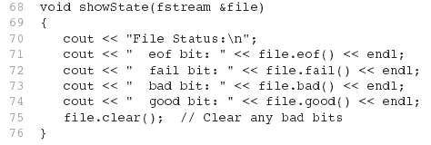
From Program 12-6

Slide 13
Binary Files

Slide 14
Binary Files
Binary file contains unformatted, non-ASCII data
Indicate by using binary flag on open:
  inFile.open("nums.dat", ios::in | ios::binary);
12-<number>

Slide 15
Binary Files
Use read and write instead of <<, >>
  char ch;
  // read in a letter from file
  inFile.read(&ch, sizeof(ch));
  // send a character to a file
  outFile.write(&ch, sizeof(ch));
address of where to put
the data being read in.
The read function expects
to read chars
how many bytes to
read from the file
12-<number>

Slide 16
Binary Files
To read, write non-character data, must use a typecast operator to treat the address of the data as a character address
  int num;
  // read in a binary number from a file
  inFile.read(reinterpret_cast<char*>(&num), sizeof(num));
  // send a binary value to a file
  outfile.write(reinterpret_cast<char*>(&num),sizeof(num));
treat the address of num as
the address of a char

Slide 17
Creating Records with Structures

Slide 18
Creating Records with Structures
Can write structures to, read structures from files
To work with structures and files,
  use ios::binary file flag upon open
  use read, write member functions
12-<number>

Slide 19
Creating Records with Structures
  struct TestScore
  {
  int studentId;
  double score;
  char grade;
  };
  TestScore oneTest;
  ...
  // write out oneTest to a file
  gradeFile.write(reinterpret_cast<char *> (&oneTest), sizeof(oneTest));
12-<number>

Slide 20
Random-Access Files

Slide 21
Random-Access Files
Sequential access: start at beginning of file and go through data in file, in order, to end
  to access 100th entry in file, go through 99 preceding entries first
Random access: access data in a file in any order
  can access 100th entry directly
12-<number>

Slide 22
Random Access Member Functions
seekg (seek get): used with files open for input
seekp (seek put): used with files open for output
Used to go to a specific position in a file
12-<number>

Slide 23
Random Access Member Functions
seekg,seekp arguments:
  offset: number of bytes, as a long
  mode flag: starting point to compute offset
Examples:
  inData.seekg(25L, ios::beg);
  // set read position at 26th byte
  // from beginning of file
  outData.seekp(-10L, ios::cur);
  // set write position 10 bytes
  // before current position
12-<number>

Slide 24
Important Note on Random Access
If eof is true, it must be cleared before seekg or seekp:
  gradeFile.clear();
  gradeFile.seekg(0L, ios::beg);
  // go to the beginning of the file
12-<number>

Slide 25
Random Access Information
tellg member function: return current byte position in input file
  long int whereAmI;
  whereAmI = inData.tellg();
tellp member function: return current byte position in output file
  whereAmI = outData.tellp();
12-<number>

Slide 26
Opening a File for
Both Input and Output

Slide 27
Opening a File for
Both Input and Output
File can be open for input and output simultaneously
Supports updating a file:
  read data from file into memory
  update data
  write data back to file
Use fstream for file object definition:
  fstream gradeList("grades.dat",
  ios::in | ios::out);
Can also use ios::binary flag for binary data

